Slide 1
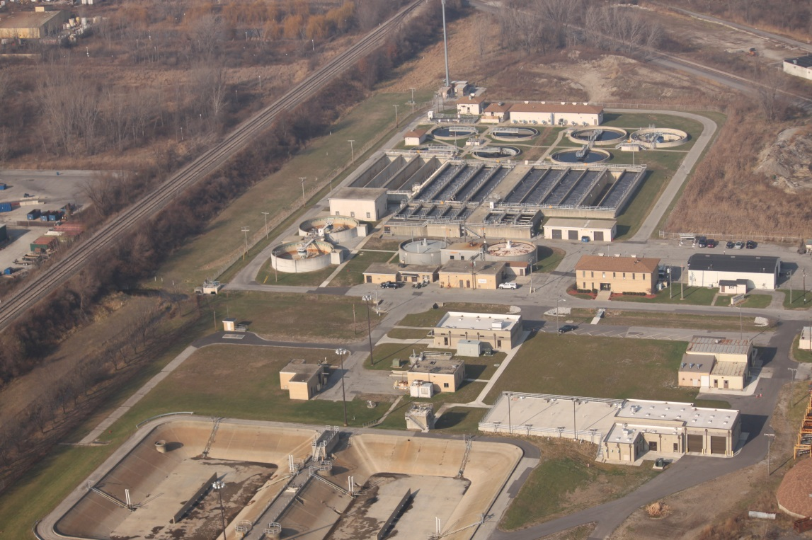
Schererville WasteWater Treatment Plant
The Schererville Wastewater Treatment Plant is located in Northwest Indiana and serves the wastewater needs of a population base of approximately 45,000 people in the communities of Schererville and St. John. The Schererville Wastewater Treatment Plant was built in 1964, at the time serving approximately 2,000 people with an Average Daily Capacity of 500,000 gallons per day. We now have a Design Average Capacity of 8.75 million gallons a day and a Peak Design Capacity of 16.6 million gallons a day and operate 21 sewage lift stations. Here at the Schererville Wastewater Treatment Plant, many processes are used to convert wastewater or sewage into safe and reusable products. The main product is clean, safe water. The second, or bi-product, is bio-solid materials, which are used as fertilizers on farm grounds in the surrounding areas.

Slide 2
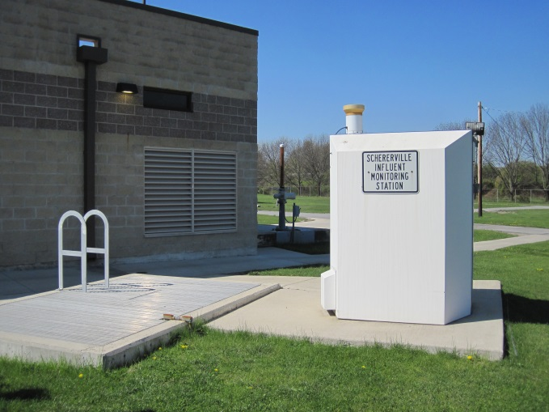
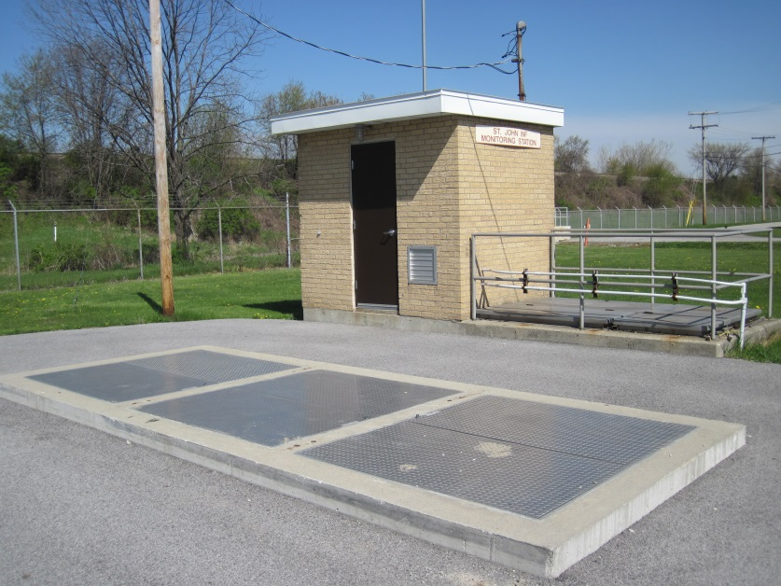
Influent Sampling
The Schererville Wastewater Treatment receives flow from not only the Town of Schererville and the unincorporated areas of town, but also from the Town of St. John. To determine what process control measures are required of our staff, flows coming into the facility from both communities are monitored and sampled automatically on a 24 hour per day basis. Flow proportionate samples are taken at two points in the facility in Schererville, as well as St. John. These composited samples are collected and analyzed 7 days a week to determine influent loading for both communities.
Schererville
St. John

Slide 3
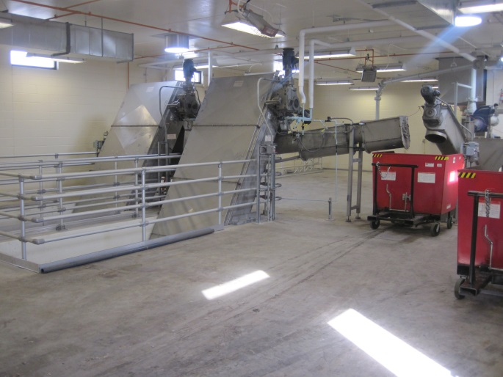
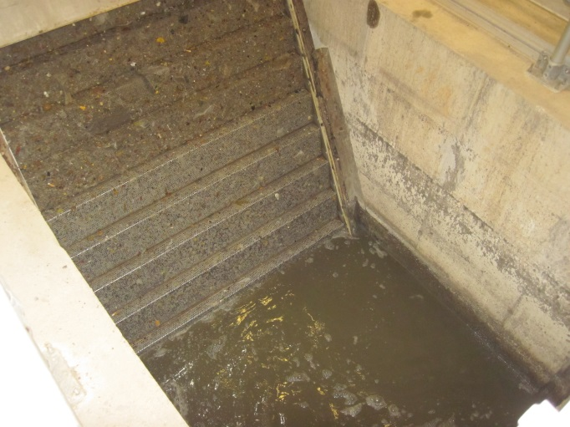
Preliminary Treatment: Perforated Plate screens
One of the first steps in the wastewater treatment process is the filtration of solids from the incoming flow. A simple yet effective piece of filtration equipment, the perforated plate screen, consists of perforated stainless steel panels that are carried by two heavy duty chains. The screen panels are formed to create steps giving the ability to remove larger screenings and to increase the effectiveness of the screening area. Some examples of screenings include sticks, rags, pop cans and larger solids. The screenings are then removed, washed, and sent to a sanitary landfill for disposal. With this process, we can protect other plant equipment from damage that these materials could cause.

Slide 4
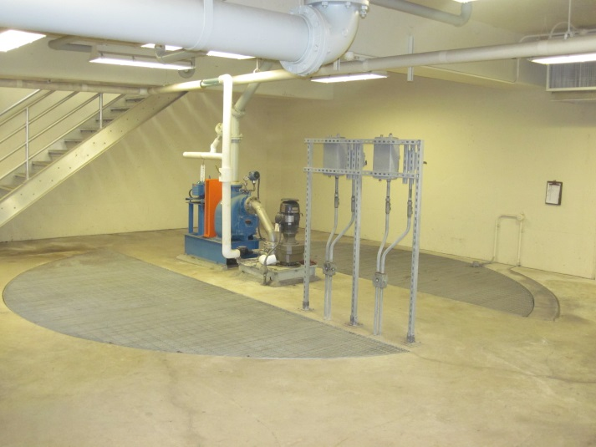
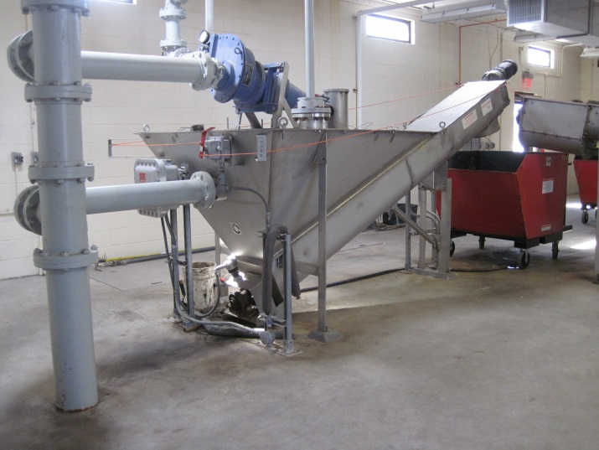
Preliminary Treatment:
Grit Removal
Because the Schererville Wastewater Treatment Plant is a biological treatment process facility, inorganic materials need to be removed prior to entry into this process. Such materials include sand, rocks, and glass. This is collectively known as grit.
The flow is slowed down enough in the grit tank to allow the grit to settle out. The grit tank is designed so the flow is maintained at a high enough velocity to keep organic waste materials in suspension. The inorganic materials are then removed, washed, and then sent to a sanitary landfill for disposal. With this process, we can protect other plant equipment from damage that these materials could cause.

Slide 5
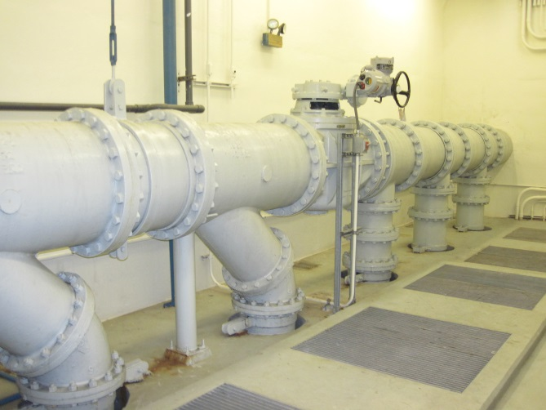
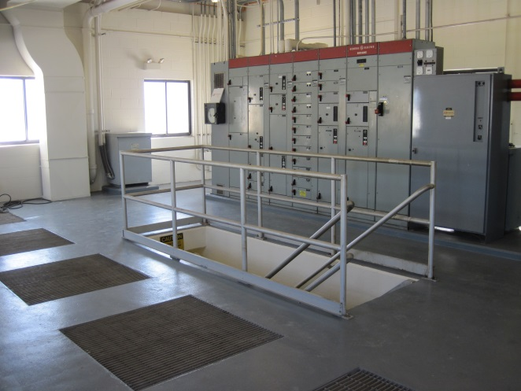
Raw Sewage Pumping Station
Wastewater flows for the most part by gravity, through sanitary sewer lines. Throughout the town, because there are literally hundreds of miles of sanitary sewers, pumping stations are sometimes required to lift the sewage so that it can continue to flow by gravity. Presently, there are 21 lift stations throughout the town, which lift the wastewater so that it can flow by gravity to the Wastewater Treatment Plant. All combined flows from our sewer district enter the Raw Sewage Pumping Station. This pumping station consists of five large pumps that have a combined capacity of pumping over 35,000 gallons per minute to the facility. Before entering the pump station well, the wastewater goes through Preliminary treatment where large debris such as rags, sticks, and trash are removed as well as the smaller particles like sand, rocks, and glass. The large sewage pumps then pump the flow from approximately 26 feet below ground to a height of 15 to 20 feet above grade to the primary clarifiers. From there the sewage can flow by gravity to the remainder of the facility.

Slide 6
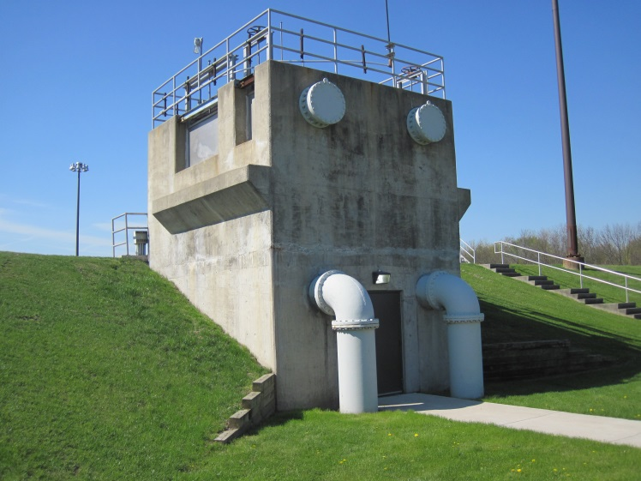
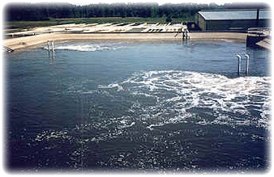
Flow Equalization Facilities: Storage Ponds
During storm conditions or cases of industrial loading, a portion of the flow can be diverted to these two Flow Equalization Ponds. Each pond holds approximately 1.6 million gallons of storm water. While the flow is being held in these ponds, huge mixers and aspirators mix and diffuse air into the waste stream. This is done to keep solids in suspension and to keep the wastewater from becoming septic and causing odor problems in the community. Once the storm has passed, the wastewater is then drained back to the facility and treated with the other incoming flow.

Slide 7
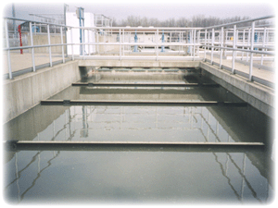
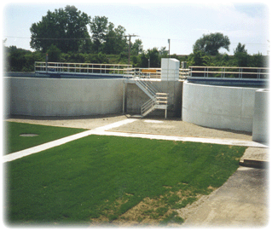
Primary Treatment:
Primary Clarification
Two sets of Primary Clarifiers 1 through 8 (rectangular) and 9 & 10 (circular) provide the first form of treatment. Primary treatment is a gravity type process where flow is slowed down and solids are allowed to settle out.
These clarifiers are large settling tanks and allow about 20 to 30% of the solids to settle out. These solids, called sludge, are removed and sent to large heated anaerobic digesters to be processed into bio-solids. This digestion process, which in nature would take months or years to perform, is completed in the accelerated environment in approximately 13 to 45 days. Primary Clarifiers 9 & 10 were originally a Wastewater Treatment Plant in 1964. In a cost effective move, the old treatment plant was rehabbed. Additional tank wall height was constructed and new equipment installed to convert the old Wastewater treatment plant into Primary Clarifiers.

Slide 8
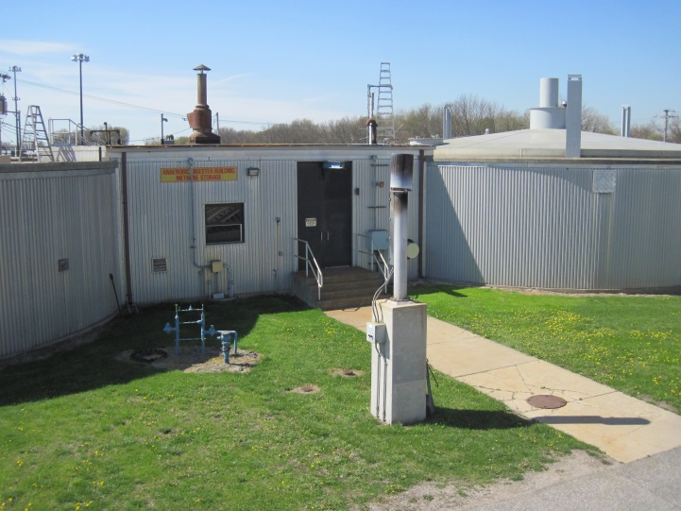
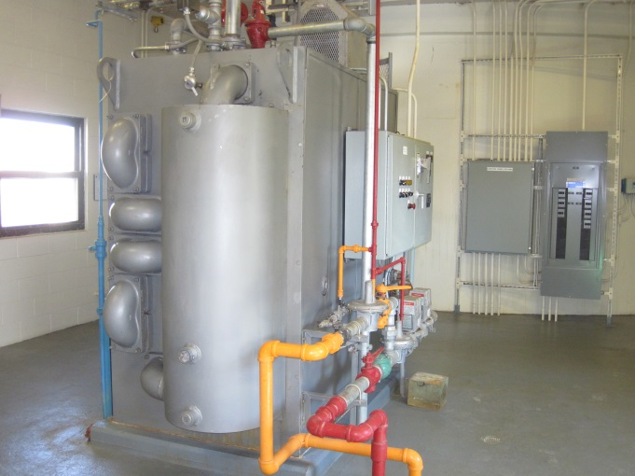
Sludge Digestion Process:
Anaerobic Digestion
Sludge that is removed in the Primary Clarification process is sent to our Anaerobic Digesters. A similar process would be a septic tank. This is a high performance version of that. Septic tanks, which run at ground temperature, can take months or even years to partially digest the sludge produced. Our Anaerobic Digesters which hold a combined capacity of over 600,000 gallons of sludge are heated to a temperature of 95°F. Special forms of bacteria that live in this non-air environment or anaerobic environment convert organic material into safe and stable bio-solids and produce methane gas. The methane gas is captured underneath the floating domes and provides the fuel for the sludge heater to heat the sludge thus eliminating the need for the use of natural gas. This saves thousands of dollars annually on our utility bills.

Slide 9
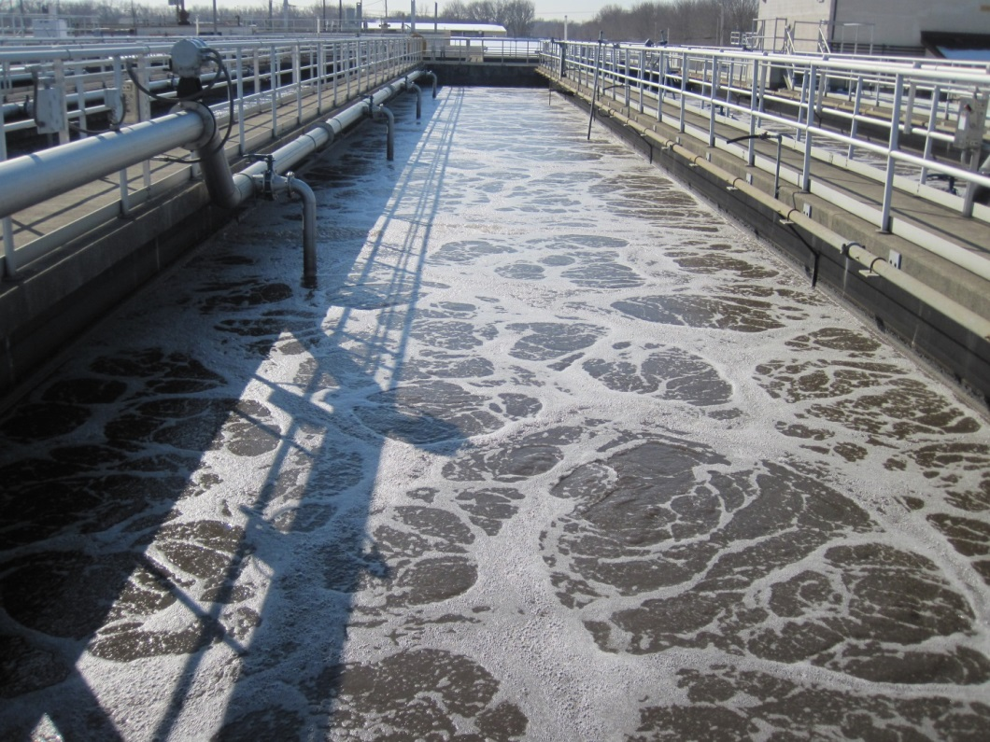
Biological Treatment Process:
Aeration Tanks
The Schererville Wastewater Treatment Plant employs an activated sludge treatment process. This activated sludge or biomass is a mixture of waste and microbiological cultures. Billions upon billions of bacteria consume the organic material converting it into bio-solids. This bacteria or biomass is closely monitored to keep the bacteria in the perfect balance to perform the aeration process effectively and efficiently. There are many types of activated sludge treatment in the wastewater industry. The type of treatment that the Town of Schererville employs at its Wastewater Treatment Plant is called single-stage nitrification. Not only is organic material consumed, but ammonia nitrogen is also removed during this process.

Slide 10
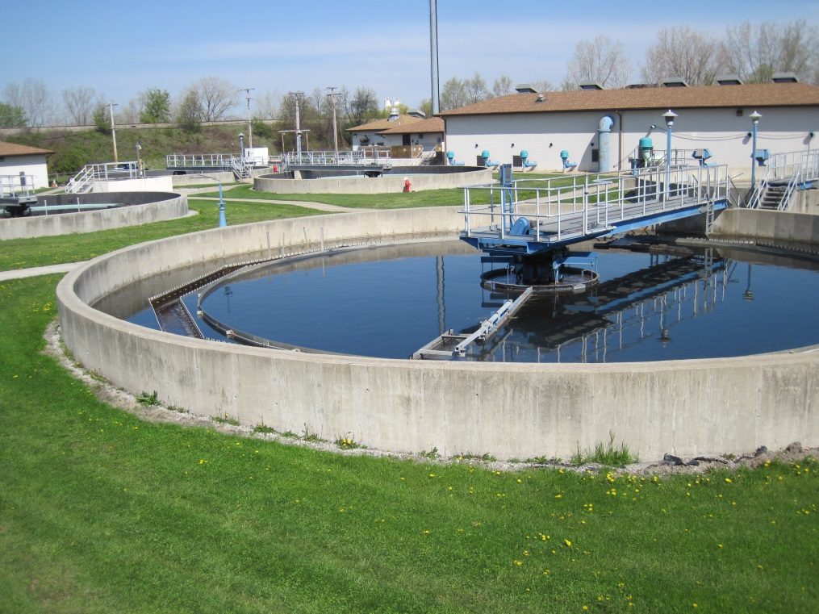
Secondary Treatment:
Secondary Clarifiers
The highly mixed wastewater and biomass flows into the Secondary Clarifiers where biomass is separated from the water. The biomass that settles to the bottom is returned to the aeration tanks to begin the aeration process all over again. The treated water then flows to the disinfection process. The average removal rate of our Aeration Process and Secondary Clarifiers is around 93% to 95% of the incoming flow.

Slide 11
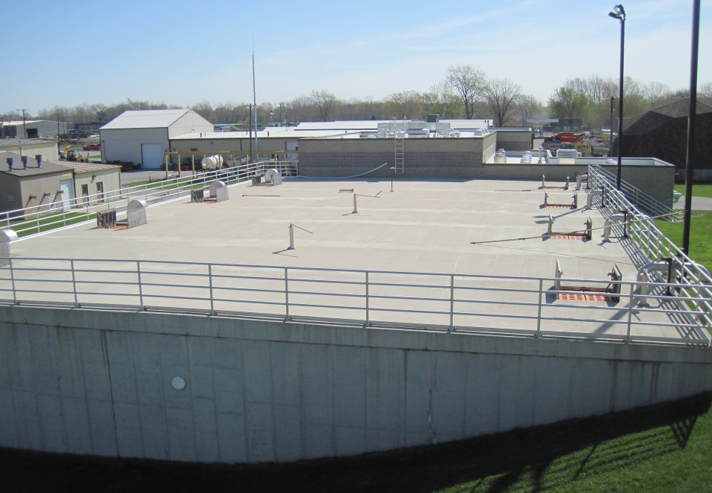
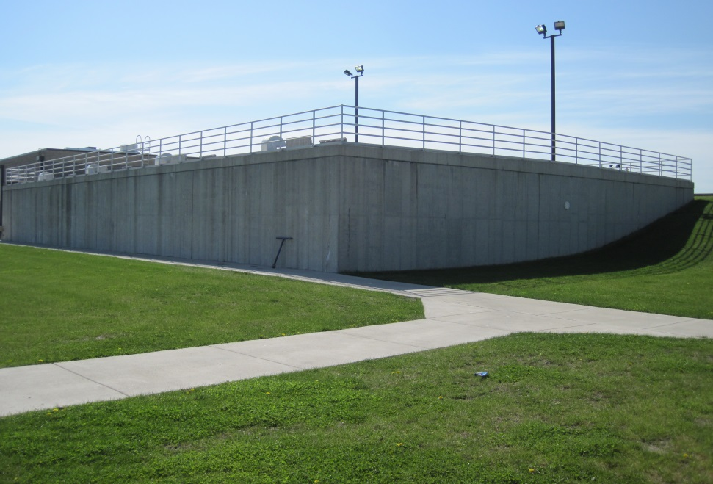
Sludge Digestion Process:
Aerobic Digestion
Waste activated sludge or excess bacteria that is created in the secondary process and by the activated sludge process is sent to the Aerobic Digester Complex. This waste activated sludge is removed from the food source and the bacteria basically become cannibalistic, consuming each other and in turn this process produces a high quality bio-solid.
The Aerobic Digester consists of four covered rectangular tanks with space for a fifth future tank. The four tanks include a waste activated sludge (WAS) storage tank and three aerobic digester tanks for a total combined capacity of approximately 680,000 gallons. The four tanks are equipped with fine bubble disc type membrane diffusers. Each tank is served by a single adjustable speed rotary air blower with a common stand by unit. The digestion tanks can be operated individually or in series. Each tank is equipped with a drain, overflow, decant swing pipe, and a valve connection to the adjacent tanks.

Slide 12
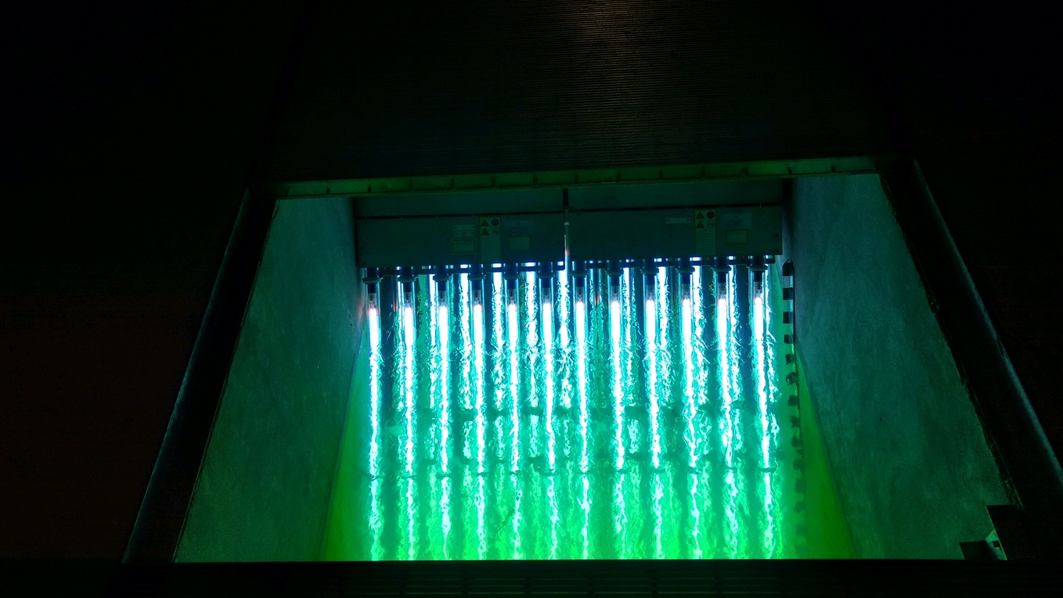
Final Effluent:
Ultraviolet Disinfection
Treated water, although clean, may still contain pathogenic organisms, which could cause disease in the receiving stream. These pathogenic organisms are commonly referred to as e-coli. Because of this, every gallon of effluent is disinfected with ultraviolet light. Ultraviolet disinfection is much safer to the environment and takes place by the water passing over 48 UV-bulbs, where the water is completely disinfected within seconds.

Slide 13
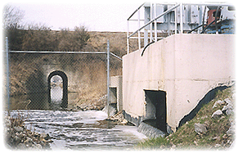
Final Effluent:
Receiving Stream
After disinfection, the water is discharged into the receiving stream. The flow, similar to the influent, is constantly monitored and sampled proportionately 24-hours a day, 7 days a week. The flow is analyzed in our laboratory daily to ensure the quality of the water leaving the facility.

Slide 14
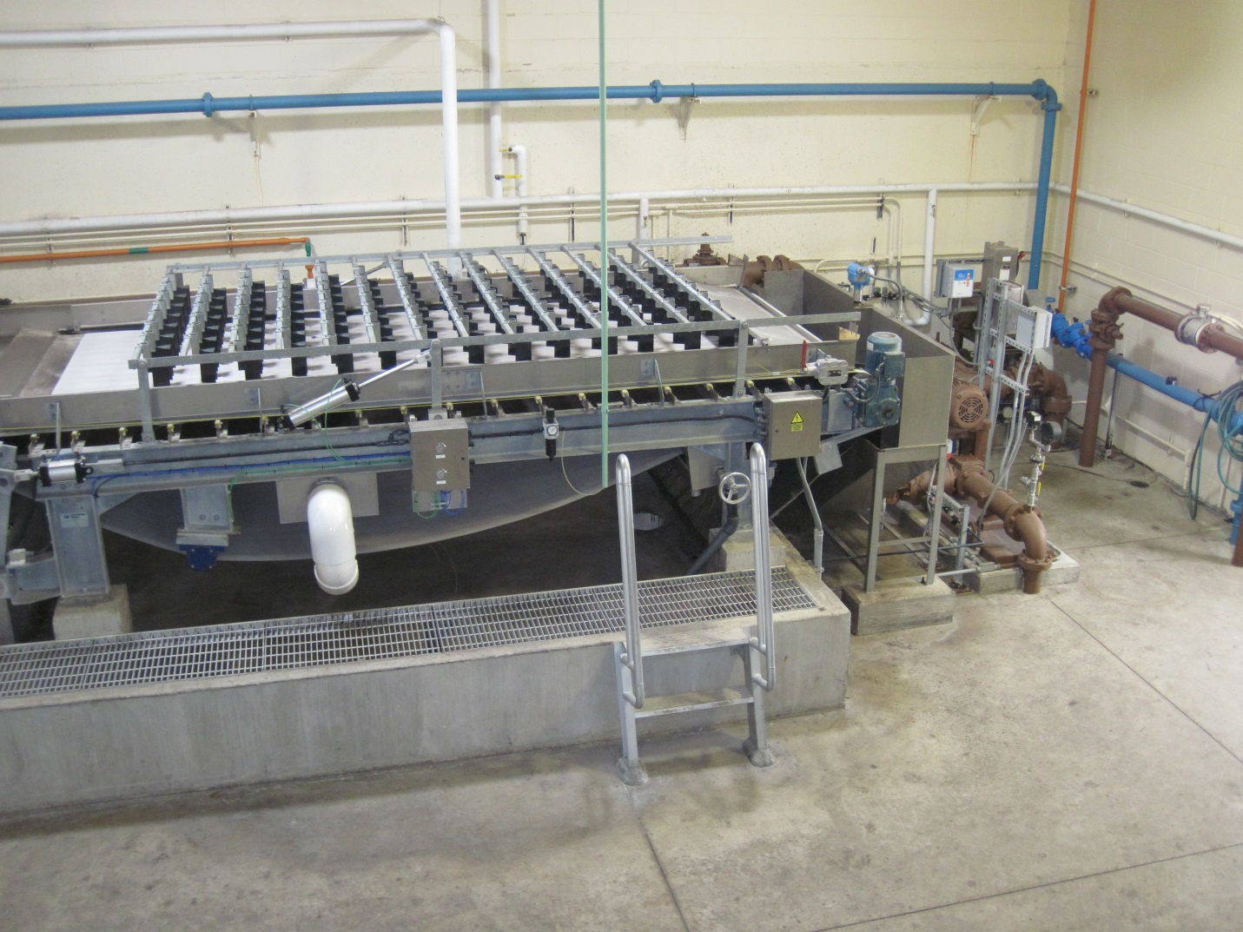
Sludge Treatment:
Gravity Belt Thickener
The gravity belt thickener is a highly effective tool for de-watering. It operates quietly at a minimal cost, consuming a low volume of wash water. Sludge is flocculated by the use of polymers, introduced on the belt, and the released water is drained through the gravity belt. While the process is simple, the decrease in sludge volume is impressive. The gravity belt thickener reduces the volume of thin sludge and slurries produced during the municipal or wastewater treatment process. The principle of the gravity belt thickener is simple: sludge is flocculated with polymers and the released water is drained by gravity through a traveling filter belt.

Slide 15
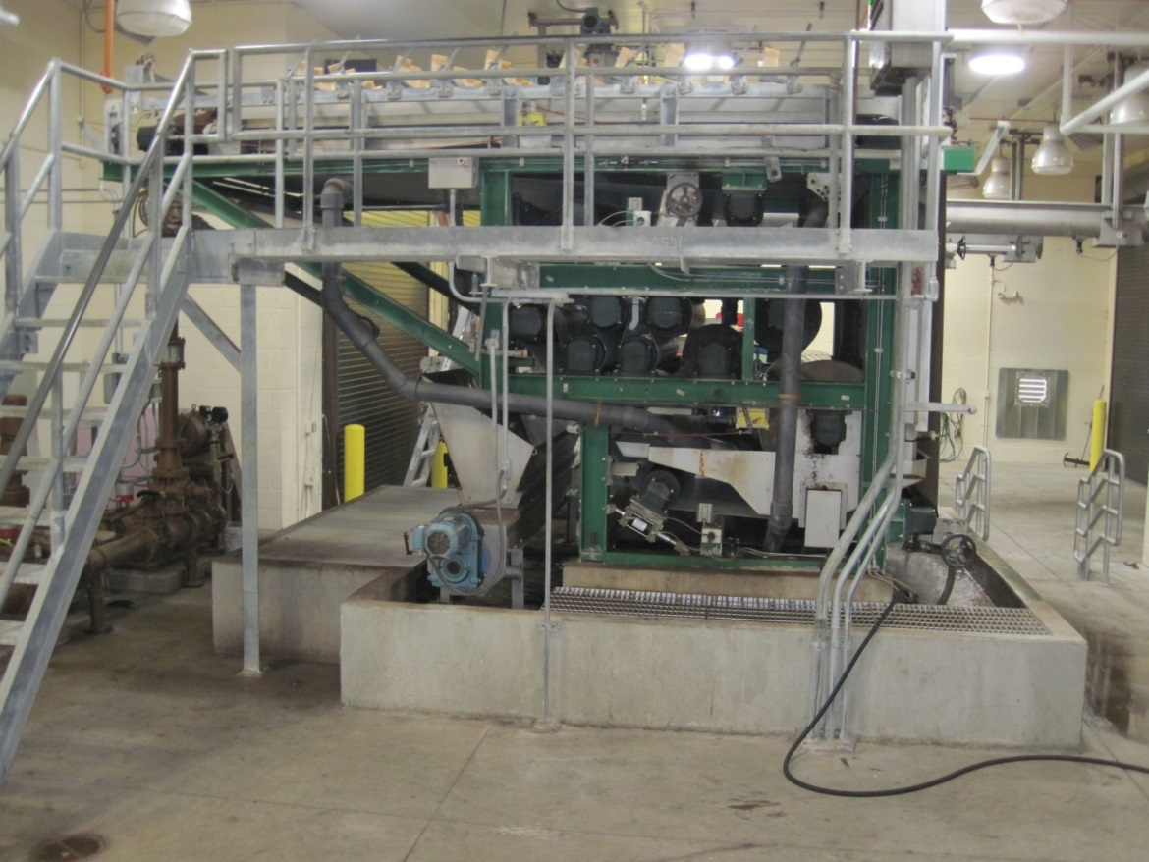
Sludge Treatment:
Belt Filter Press
A belt filter press is a bio-solids dewatering device that applies mechanical pressure to a chemically conditioned sludge, which is sandwiched between two belts, by passing those belts through a serpentine of decreasing diameter rolls. The machine can actually be divided into three zones: the gravity zone, where free draining water is drained by gravity through a porous belt; the wedge zone, where the solids are prepared for pressure application; and the pressure zone, where medium, then high pressure is applied to the conditioned solids.
Typically, a belt filter press receives a sludge ranging from 1-4% feed solids and produces a final product of 12-35% cake solids. Performance depends on the nature of solids being processed.

Slide 16
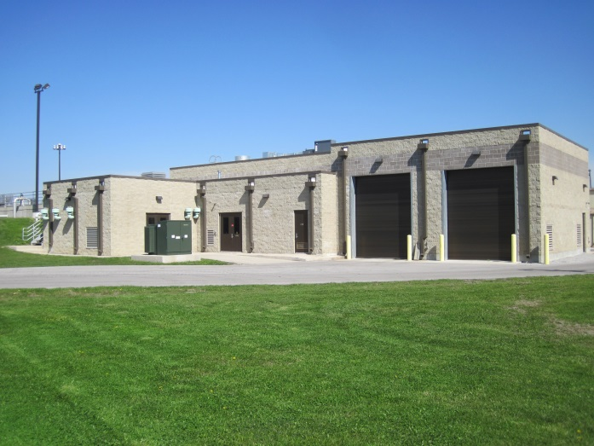
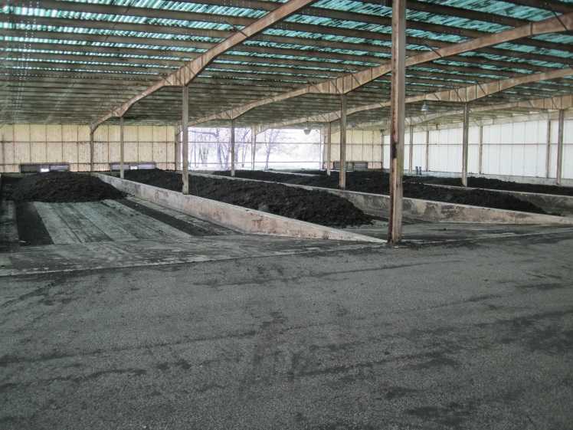
Bio-solids Handling
Sludge Handling
Once the sludge is dewatered it is loaded into trucks by a series of automated augers and gates and transported to the Bio-solids Storage building which is located within the Wastewater Treatment Plant until it can be later transported to local farm grounds.
Storage Building
Sludge is stored at the facility so that it can be coordinated with the growing cycles on our farm sites. Bio-solids are applied to the farm sites in the spring and the fall of the year. Bio-solids are analyzed throughout the year to ensure pathogen destruction and vector attraction requirements are met to ensure that the bio-solids are in a safe form for land application and agricultural use. The bio-solids that do not meet the state and federal governments rigid requirements are diverted to a sanitary land fill along with the grit and screenings that are removed at the head end of the process.

